Slide 1
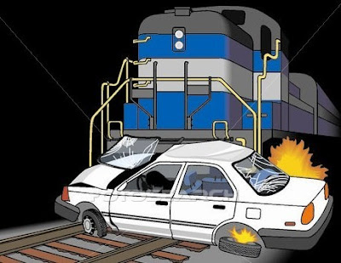
US Highway RailRoad Crossing Accident
DATS 6103 PROJECT
Team 3 Members:
Aakash Hariharan
Abhilasha Singh
Trisha Singh
Vishal Fulsundar

Slide 2
Overview
Purpose
Smart questions
Data Overview
Data Analysis
Using visualization
Addressing SMART Questions Building Models
Conclusion

Slide 3
Purpose
Summarize important background research and EDA
Answer the SMART questions by building models

Slide 4

Smart Questions
1.How can we predict the severity of a driver's injury in a railroad crossing accident using factors like weather, crossing type etc.
2.How can we identify accident-prone locations in USA based on accident frequency over the past 46 years and what are the key factors contributing to the higher frequency of accidents in these areas?
3.

Slide 5

Dataset Details
US Highway Railroad Crossing Accident dataset sourced from Kaggle
Dataset contains,
120365 observations
46 variables
Railroad Information, Incident Details, Location Information, Highway and Crossing Details, Vehicle Information, Train Information, Environmental Conditions

Slide 6
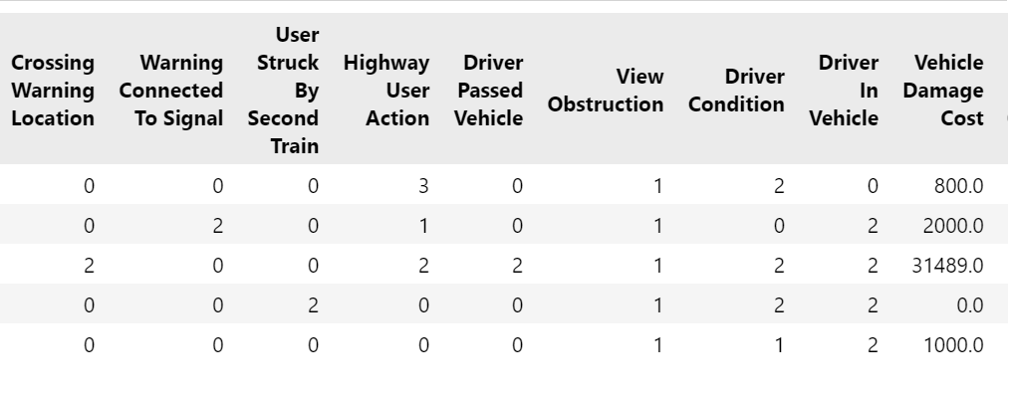
Preprocessing Overview
No missing values
Drop Duplicate rows
Data Type Conversion
Has outliers but useful

Slide 7
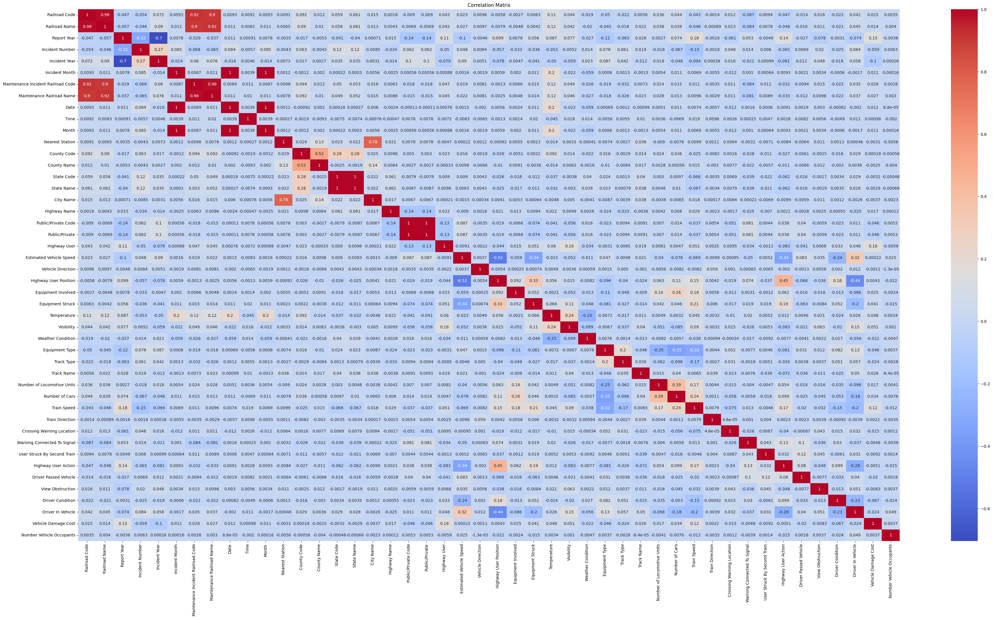
Data Visualization Exploration
Correlation Matrix
Insights:
Year, Month, State, Weather, Train Speed, and Highway User Position are among the various variables that show correlation.

Slide 8
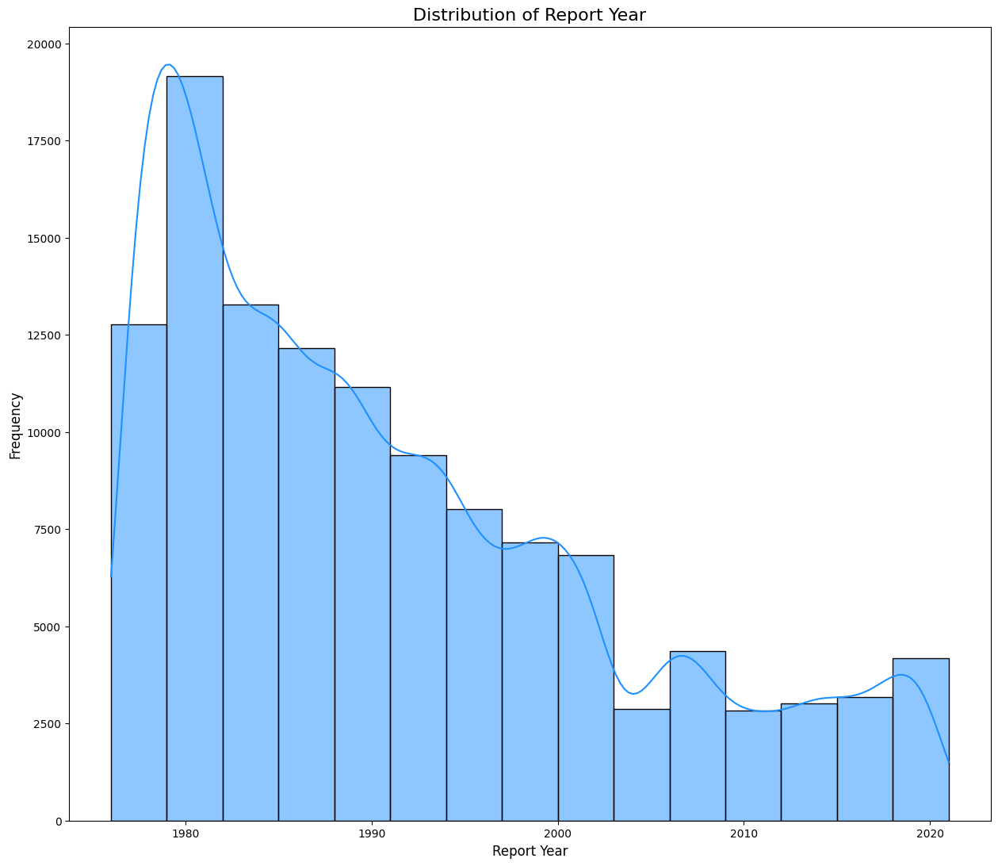
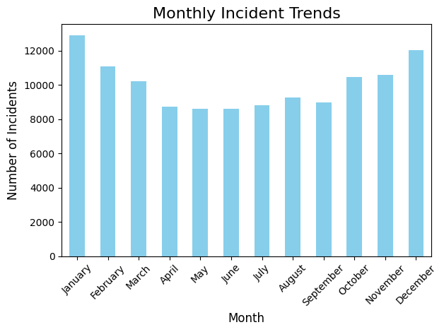
Data Visualization Exploration
YEAR : In 1980, the incident count was significantly higher, but over the years, there has been a sharp decline in the number of incidents.
MONTH : January and December show the highest number of incidents, while April, May, and June experience a small drop of around 3,000 incidents.

Slide 9
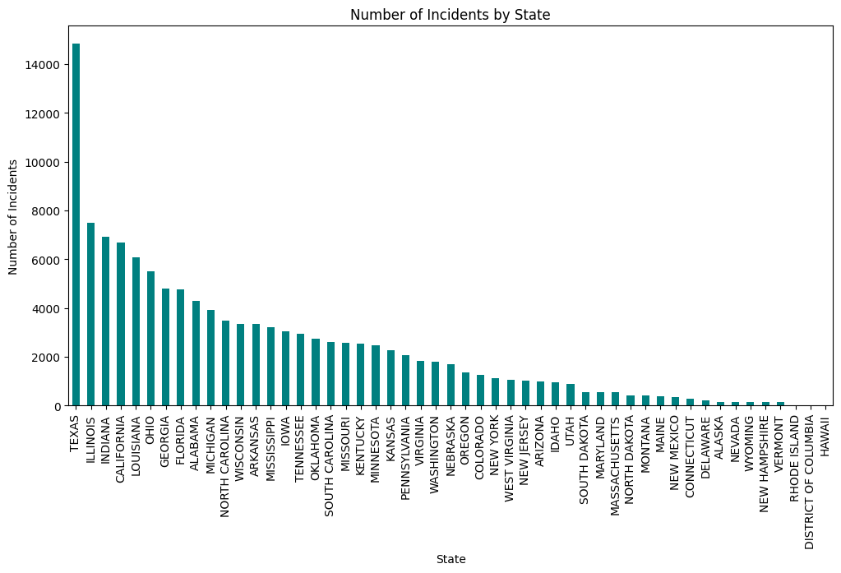
Data Visualization Exploration
STATE : Texas has the significantly highest number of incidents, followed by Illinois, Indiana. In contrast, Hawaii and District of Columbia has almost no incidents.

Slide 10
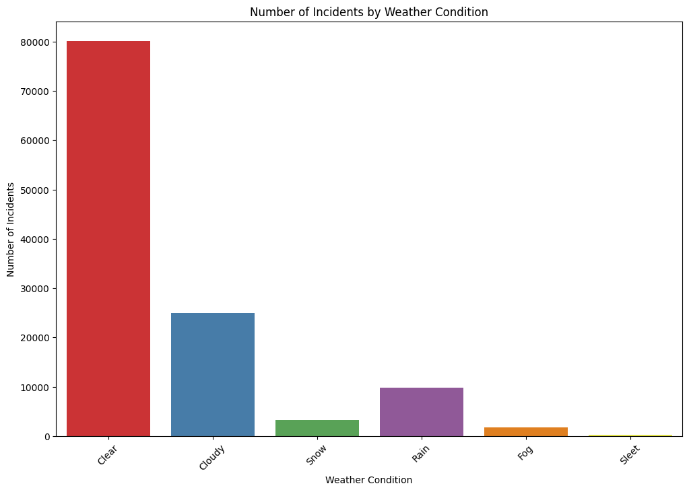
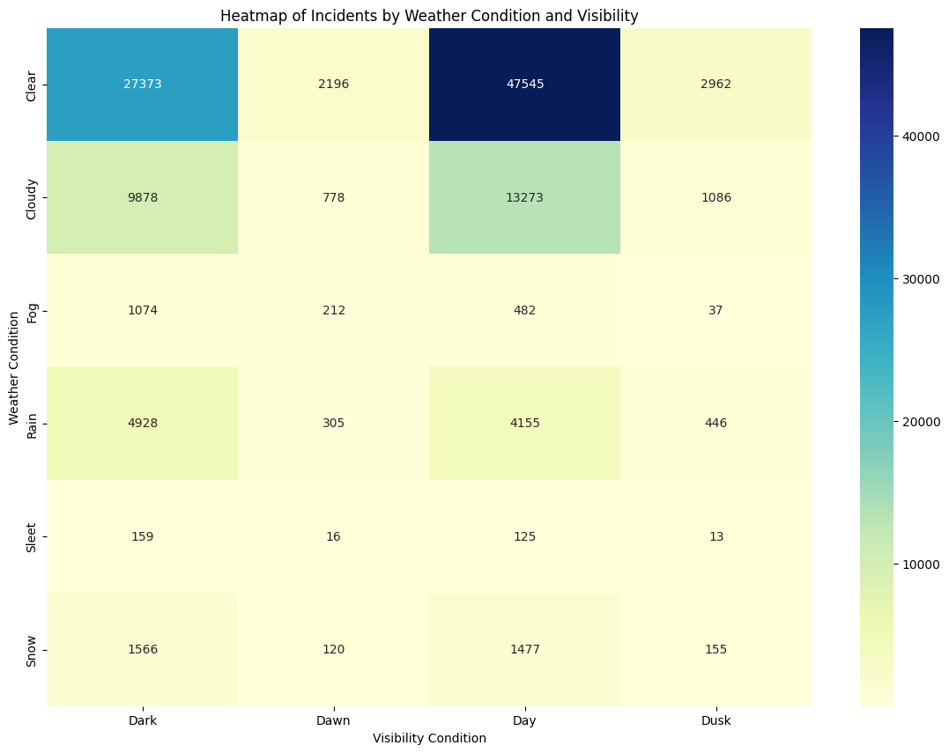
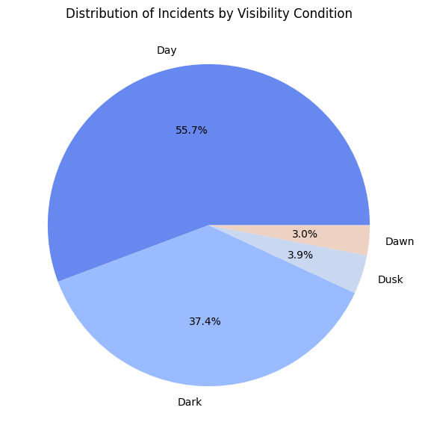
Data Visualization Exploration
WEATHER AND VISIBILITY : Clear weather is linked to a significant number of incidents. Additionally, when examining the visibility graph, we observe that 50% of incidents occur during daylight hours, followed by 38% during nighttime.
The highest number of incidents occur during daylight hours with clear skies.

Slide 11
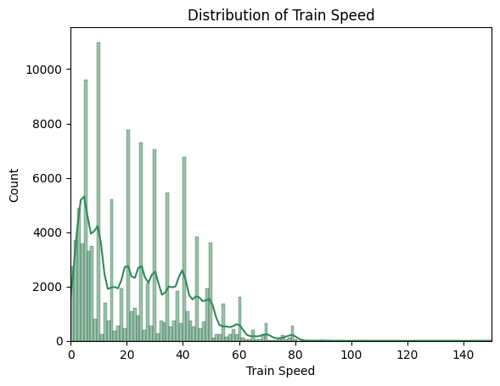
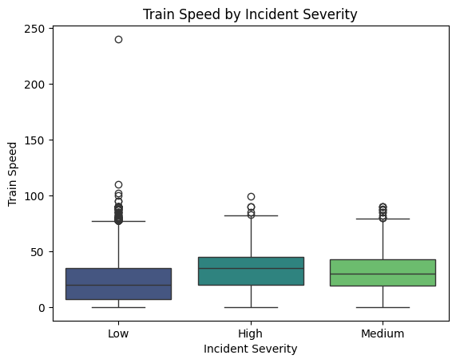
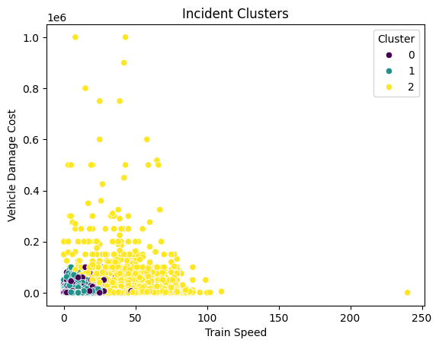
Data Visualization Exploration
TRAIN SPEED : Trains with speed less than 50 have the highest incident count.
No significant difference between severity and train speed, but a slight increase in severity with higher speeds.

Slide 12
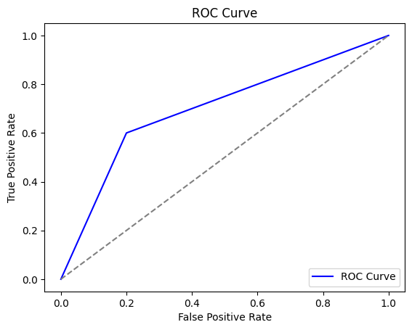
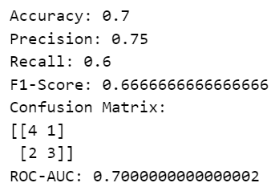
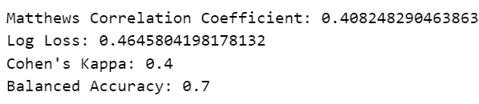
Smart Questions
1.How can we identify accident-prone locations in USA based on accident frequency over the past 46 years and what are the key factors contributing to the higher frequency of accidents in these areas?
Classification model
Insights:

Slide 13
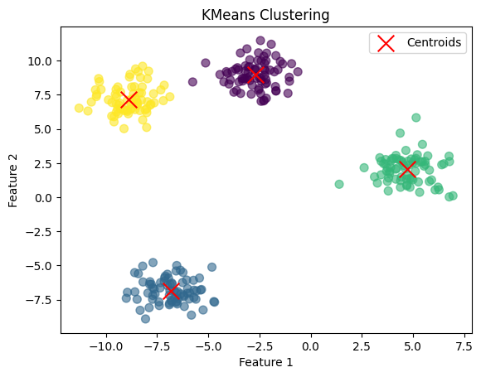
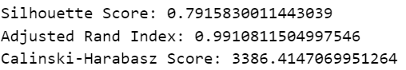
Smart Questions
1.How can we identify accident-prone locations in USA based on accident frequency over the past 46 years and what are the key factors contributing to the higher frequency of accidents in these areas?
KMeans Clustering model
Insights:

Slide 14
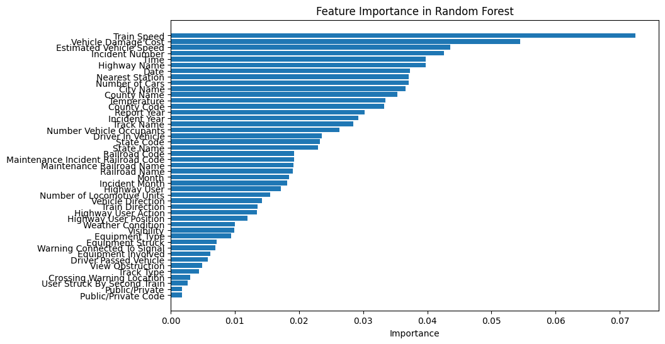
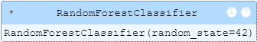
Smart Questions
2.How can we predict the severity of a driver's injury in a railroad crossing accident using factors like weather, crossing type etc.
Insights:
Dropping features with low importance

Slide 15
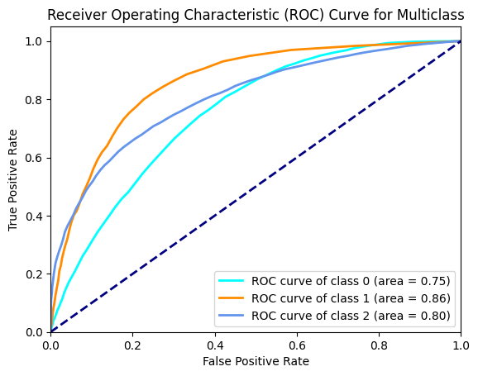
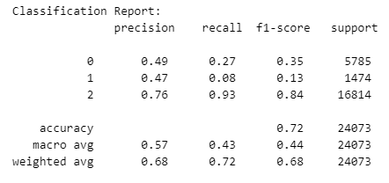
Smart Questions
2.How can we predict the severity of a driver's injury in a railroad crossing accident using factors like weather, crossing type etc.
Insights:

Slide 16
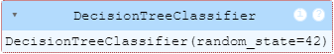
Smart Questions
2.How can we predict the severity of a driver's injury in a railroad crossing accident using factors like weather, crossing type etc.
Insights:

Slide 17
Smart Questions
2.How can we predict the severity of a driver's injury in a railroad crossing accident using factors like weather, crossing type etc.
Insights:

Slide 18
Smart Questions
2.How can we predict the severity of a driver's injury in a railroad crossing accident using factors like weather, crossing type etc.
Insights:

Slide 19
Conclusion

Slide 20

Any thoughts or questions?

